Slide 1

Digital Funds Network
Digitalising Fund Operations
FAC is a digital funds network for launching and trading investment funds
Market Engagement Deck, August 2020

Slide 2

Introducing FAC: the digital funds network
FAC is a digital funds network for launching and trading investment funds
FAC enables investors and fund product providers to connect, transact and settle at lower cost and with less friction
FAC is a private network for investors, distributors, fund managers, fund service providers and regulators
Funds launched on the FAC network, along with the cash used for settlement, are traded as digital assets
All funded trades settle immediately after pricing through atomic settlement: an on-ledger synchronised ‘delivery-vs-payment’ (DvP), which reduces delay and associated risk
Network participants benefit from distributed record-keeping shared by all parties to a transaction, significantly reducing data duplication and reconciliation across the industry
FAC provides the software that each participant operates on a distributed basis as a network of permissioned financial institutions. A governing body ensures software releases and network principles are appropriately managed
Notes:
Potential savings in UK market alone is est. $3.75bn in intermediary and service provider fees per annum reducing cost from $4.5bn to $0.75bn, within an industry managing $10 trillion in investor’s assets.

Slide 3
Problematic funds value chain
The industry framework supporting the launching and trading of investment funds is inflexible, suffers from duplicated data and is expensive: ultimately this creates a negative impact on returns for funds and their end investors.
Customers / Users
Their Pain
Our Solution
Investors
Investing in funds is expensive and opaque
Extended settlement = time out of market
Antiquated industry processes drive digitally-savvy investors elsewhere
Lower cost fund investing
Accelerated settlement and real-time data availability
Fund trading with far less friction
Fund Managers
Competition pushing fees downward
Bloated oversight costs to ensure data accuracy from multiple service providers
Long chain of hand-offs adds cost, risk and time to distribution and cash management
Reduced service provider and distributor fees, lower oversight costs.
Simplified fund launch and distribution
Immediate availability of investor cashflow data
Fund Service Providers & Distributors
Low margins squeezed even further by funds that pay their bills
Challenges of layered-on legacy technology
Impossible to service and distribute funds digitally until fund managers want to do so
Lower-cost (-60%) platform enables lower fee models without the squeeze
Simplified operational processes
Enabling new digital services now required by their fund manager clients
3
Notes:
Over-extended inefficient ‘value chain’: each intermediary and duplicate processing adds cost, risk and time

Slide 4


What does FAC actually do?
FAC connects customers, distributors, fund managers, regulators and service providers on a distributed ledger-based network, allowing them to share the same information on ownership and transactions at the same time. The network provides the primary representation of assets, cash and transactions in participating funds within the FAC network, as fund holdings and cash are fully digitalised.
Fund (‘Transfer Agency 2.0’)
Holds units / shares in digital form to satisfy client orders
Supports income distribution to holders of digitalised fund assets
Fund
Node
Investor
Node
Investor
Investor moves fund holdings and cash onto the FAC network
Investor accesses network through web portal, selects funds and places orders
Investor data held on node and shared with network
Regulator
Node
Fund
ManagerNode
Fund Manager
FM has real time access to cash flows
FM has access to the ‘on-ledger’ share register on the FAC network
Regulator
FAC provides a facility for regulatory oversight, both through regulated entities providing key network functions, and through dedicated regulator nodes.
Network Operator
Cash
Exchange
Asset
Exchange
For pre-existing funds, FAC exchanges facilitate the issuance and redemption of digital assets
For digital funds, issued exclusively on-ledger, asset conversion is unnecessary, and the only location of the fund as an asset is FAC
Exchanges – to digitalise / redeem cash and assets
On the FAC network, assets and cash are immobilised, and settlement is purely by title transfer of digital funds and cash
The Exchanges manage wallets for Clients and Distributors within the FAC network, within which cash and fund assets are immobilised
Asset Exchange: issues and redeems digital assets; provides custody for off-ledger assets and reconciles to on-ledger digital assets
Cash Exchange: issues and redeems digital cash; holds off-ledger (fiat) cash and reconciles to on-ledger digital cash
Exchanges accommodate the need for clients and distribution platforms to manage off-ledger assets and interact in fiat currency

Slide 5






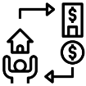


FAC Digital Funds Network - Pilot and Beyond
Fund / TA 2.0
Act as counterparty to investor trades
Holds fund assets and cash on-ledger
Manages pricing and settlement process
Fund Manager
FM has real time access to cash flows
FM has access to the on-ledger share register
Cash Exchange
Issues and cancels digital cash against fiat deposits
Digital Custody
Digital Custodian
Asset safekeeping by securing private keys
Investors
Hold cash and funds on account in digital form
Uses web portal to select funds and place trades
Controls sharing of their personal data
Can be institutional, distributor/wealth manager nominee or a retail platform
Investors
Fund Servicers
Cash Exchange
Fund Manager
FAC - Distributed Ledger Network
FAC Retail Portal
BNO
Asset Exchange
Regulator
Beyond Pilot
Retail Portal
Gives direct, low cost access to retail clients to transact on FAC
Business Network Operator
Manages network access and core network services
Asset Exchange
Supports digitalisation of off ledger assets against collateral held in safekeeping
Regulator
Provides a facility for direct regulatory oversight.

Slide 6
FAC: Benefiting all network participants
Our Product
Fund Managers | Fund Service Providers | Fund Distributors
Fund Management 2.0 | Transfer Agency 2.0 | Distribution 2.0
Real-time data transparency for all capital cashflows | Reduces key risks from missed deals, settlements & inaccurate KYC | Real-time data on investor holdings and transactions
Shorter time to market for new products / digital fund launches | Streamlined investor recordkeeping & onboarding | Shorter lead time to support clients with new fund launches
Digital funds enable lower cost service providers | New revenue streams from network services (Digital Custody, Cash Exchange) | New revenue streams from network services (node ops)
6
Notes:
More consistent service provision standards, rate cards

Slide 7
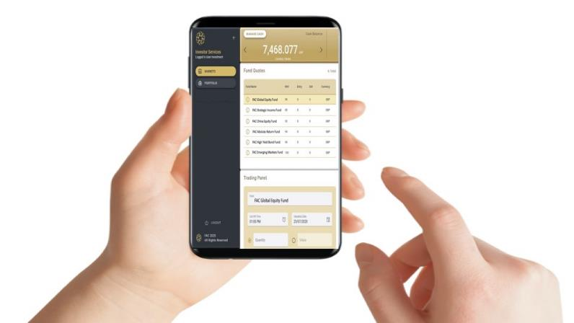
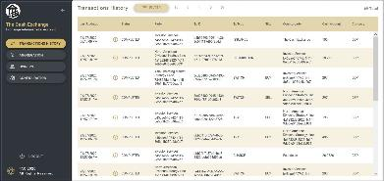

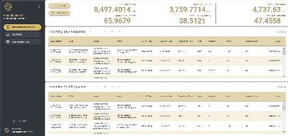
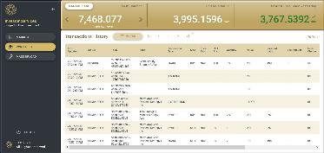
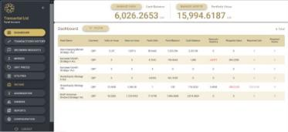



What happens on FAC?
Cash Exchange digitalises fiat currency for easier settlement
Investor tops up cash account on application
Investor selects FAC Digital Funds from available list
Investor transacts and settles directly with the Fund
Note: Mobile app is not part of the pilot and is planned for a later phase of FAC
Fund Manager sees pending trade in real time
Trade is validated on the FAC Network by the Investor Node
Fund Service Provider can approve, price and settle trades
Notes:
Provide global digital Funds services and gain early mover competitive advantage

Slide 8
FAC Roadmap - Participation
Who needs to join our journey and when?
Timeline
2023
2020
2021
2022
Pilot
(Fund Launch)
Phase 1 Go to Market
(Direct Issuance Online)
Phase 2
(Migration of Funds Issued Off-Ledger)
Phase 3
(Integration of Distribution)
Phase 4
(B2C Services on FAC)
Launch Fund Managers
Launch Fund Servicers
Launch investor platform*
Business Network Operator
Digital Custodian+
* operating in nominee role only distributor manages sub register
+ dependent on third party service evolution
Trusted Third Party
Asset Exchange Operator
Liquidity Provider
Pilot Fund Managers
Pilot Fund Servicers
Cash Exchange Operator
Off ledger support roles
Fund Accountant
Depositary
Fund Custodian
Regulator
KYC
Distributor Partnerships
Retail Portal Operator
KYC Service providers+
Driving take on of funds and
Moving into new jurisdictions
Phase 5 - 2025 - Underlying Assets and Fiat Currency On-Ledger
Full fund servicing value chain with custodians and accountants on ledger + move towards central bank digital currencies replacing cash exchange

Slide 9
Traction
Business Traction
☑
4 years of market engagement
☑
FCA Regulatory Sandbox ‘Cohort 6’
☑
Depositary & Trustee Association support
☑
3 years of product design
☑
Investment Association support
☑
Money Market Association support
☑
PoC completed with RBC
Aegon
Alliance Bernstein
Aberdeen Standard
Fidelity International
HSBC AM
Legal & General IM
UBS
Legg Mason
M&G
RBC
BNY Mellon
HSBC Securities Services
Standard Chartered
And more to come…
☑
FAC Strategic Advisory Group running with 10 Fund Managers
☑
7 Fund Managers in pilot
☑
3 Fund Service Providers in pilot
☑
R3 as tech partner
☑
Over 3K development days in FAC product
☑
2 Distributors in 2nd pilot
9

Slide 10

SUPPORTING SLIDES TO BE SELECTED
FROM DEPENDING ON AUDIENCE

Slide 11


























Leadership team
Combined experience of 100’s of years working in key roles within the financial markets including:
BRIAN MCNULTY
CEO
20+ years buy-side/fund admin, last 4 specialising in blockchain as Global Head of Services at R3.
Serial entrepreneurial success, co-owning companies including DBFS Consultancy, Tradermade International, Asset+ Fund of Funds platform
Founded Post Trade Distributed Ledger Group (PTDL) of 40 financial blue-chips
https://www.linkedin.com/in/brianmcnulty/
IAN HUNT
Product Design Lead
30+ years buy-side/fund admin, last 4 in DLT Senior advisory roles include HSBC, M&G, Insight, RLAM, RBS
2+ years FAC design lead
https://www.linkedin.com/in/ian-hunt-228880/
PETE TOWNSEND
Market Development
25+ years funds, last 4 in blockchain / start-up growth
Ex COO/head of product and solutions BNP Paribas SS
Leadership roles at Fidelity and in offshore fund admin
https://www.linkedin.com/in/pete-townsend-1b18301a/
DAVID RUTTER
Strategic Advisor
CEO of R3
30+ years wall streets top institutions incl. 10+ as CEO of Electronic Broking at ICAP and previous as co-owner of Prebon Yamane
https://www.linkedin.com/in/daviderutter/
MELISSA MILLER
Funds and Regulatory Design
25+ years delivering large-scale initiatives to global asset management groups
Over 50 single- and multi-manager investment platforms across most major domiciles worldwide.
https://www.linkedin.com/in/melissa-miller-7315752/?originalSubdomain=uk/
MARK HARRISON
Head of FAC Fund Design
30+ years buy-side/fund admin
Senior strategy roles at BNP Paribas, Hermes, AMP AM
1.5 years leading FAC FM design
Recognised operations transformation specialist
https://www.linkedin.com/in/mskharrison/
CHRIS BALDWIN
Product Build Manager
Overseeing team of FAC Software Developers
18 years as Senior IT Project Manager / Programme Manager at GAM
https://www.linkedin.com/in/cmbuk/
REYER KOOY
FAC Money Market Fund Lead
MD / Head of Liquidity Management, Deutsche Bank EMEA/APA
Director of the Institutional Money Market Fund Association https://www.linkedin.com/in/reyerkooy/

Slide 12


RBC Proof of Concept
The Proof of Concept exercise was conducted in Feb/Mar 2020 with Royal Bank of Canada Transfer Agency Operations in Dublin
A series of interactive workshops was held over 8 weeks with a dedicated FAC network environment to engage with, understand and validate the ‘TA2.0’ model
There was active participation from RBC Product and Operational SMEs
Based on the ‘day in the life of a fund’ (DITLOAF), we walked through the principal activities of a TA for investor take on, order management, pricing and settlement and income distribution
Follow-up analysis of benefits and the proposed commercial model has fed into RBC’s internal business case for further engagement with FAC
RBC concluded that FAC implementation could deliver a significant reduction in their TA operational costs

Slide 13





Client Servicing
(Client = Fund Manager or other Inst. Investor)
TA 2.0 Impact
How the function improves
Part of Successful PoC?
Closing Gaps
Mostly the same
Material changes
Eliminated
Ready for Q3/4 Pilot?
Function streamlined by shared data for all network participants¹
Becomes a core function/feature of the FAC network
P
Process design w/ light dev
Market partner dependent
Roadmap development
TA 1.0 Functions
M
Transaction Management & Settlement
R
NAV Pricing
TA 2.0 client/fund manager servicing team responsibility, albeit with access to investor data shared with the Fund Node
PARTIAL
P
M
R
YES
Distributions
Digitalisation of cash and fund shares enable coupling of the transaction and the related settlement in real-time
Investors and Funds top-up or cash out via Cash Exchange
PARTIAL
P
M
R
PARTIAL
Registration
Fund Accountant provides NAV and receives TA data as in TA 1.0
Immediate access to official NAV for network participants
YES
P
M
R
YES
AML/KYC
Digitalisation of cash and fund shares enable coupling of the distribution, reinvestment and any related settlements in real-time
Automated allocation to nominee-based investors
YES
P
R
YES
Document Management
Transactions & investor data changes are initiated on Investor Node
TA 2.0 role ensures compliance with fund/jurisdiction rules
YES
P
R
YES
Distributor Management
KYC performed by operator of Investor Node (i.e., institutional investor, distributor, also KYC’d ) through a KYC utility for the network as a whole, and AML controls run by Cash Exchange.
NO
P
M
R
PARTIAL
Regulatory & Tax Reporting
Operator of Investor Node (nominees) will maintain the relevant documents for investors on their node
Relevant documents can be attached to all transactions in FAC
NO
P
R
YES
Investor Servicing
Distributor operates their own Distributor Node where all of their transactions, fees and data changes are initiated
YES
P
M
R
PARTIAL
Reconciliations
Reporting utilities leverage data and FAC-native tax/fiscal agent calculations on the Fund Node
NO
P
M
R
PARTIAL
TA 2.0 investor servicing team responsibility, albeit with access to investor data shared with the Fund Node
YES
P
R
YES
As nodes are always in synch and transactions and settlements are coupled, reconciliations of cash settlements against share transactions and to other participants’ records are not required
YES
YES
Note 1 – One of the core features of Corda, the distributed ledger framework on top of which FAC operates, is that only the network participants party to a transaction have access to the related data.

Slide 14


Forthcoming Pilot: FAC – ‘Day in The Life of a Fund’
1 Fund Manager will launch a real fund with real money in the FCA Sandbox
Another 6-9 (max) will follow the same process / realise the same benefits but with a simulated fund, ‘serviced’ by 3 (max) Global Custodians to realise the benefits of reduced complexity in TA/Fund Servicing
Pilot planning focuses on the core fund operating cycle – aka ‘DITLOAF’ encompassing the normal fund servicing activities (order processing, cashflow management, valuation / pricing, issuance, settlement, related oversight)
High level process is unchanged but FAC innovation redefines its execution
One process – three radical ways to redefine it and deliver operating efficiency
Order Processing
Cash Flow Management
Valuation and Pricing
Settlement
Oversight
Data is shared instantly – delivering real-time visibility for all participants
Cash and assets are digitalised – redefining ownership and title, speeding up settlement
Investors can participate directly on ledger – radically redefining existing distribution models
Eliminates IT complexity – booking and settlement risk – reconciliation - delays and inefficiency

Slide 15
FAC Roadmap - Milestones and Deliverables
Timeline
2023
2020
2021
2022
Pilot
(Fund Launch)
Phase 1 Go to Market
(Direct Issuance Online)
Phase 2
(Migration of Funds Issued Off-Ledger)
Phase 3
(Integration of Distribution)
Phase 4
(B2C Services on FAC)
See detailed pilot engagement doc, FCA plan and build plan Summary
See post pilot high level plan and description (attached slides)
Operating model validated
Commercial model validated
Mature adoption plan
Participant commitment to next phase
Production capable network delivered
Fund launched and invested
Legal and governance framework in place
Asset Exchange Live
Off ledger issued funds live
Liquidity Provider live
On ledger sub register capable
Increased Distributor participation
B2C Portal live
KYC Service live
Deliverables
Resources committed
Cash exchange operator identified
FCA Sandbox Acceptance
Environment build complete
Fund launched
Pilot success criteria met
Got to market model agreed
Go live Participants committed
Digital Custodian committed
BNO operator committed
Due diligence complete
Regulatory approval for fund
Live Fund Launch
Off ledger participants committed
Off ledger operating model agreed
TTP and exchange operator engaged
Liquidity provider identified
Distribution partners committed
Distribution model validated
Pilot phase signed off
Business model validated
Prototype portal built and tested
KYC service provider engagement
Milestones

Slide 16
Phase 1 - Go to Market Plan Summary
Fund Launch Pilot – Brings together key stakeholders to help define the plan with a focus on validation of TA 2.0 operating model and demonstrating the business case. Outcomes from this feed directly into the delivery plan:
Go to Market Target Model (GMTM) – Defining the day 1 model (market, product and operational). Driving out the details of what’s required to go live with version 1 of FAC.
Governance, Legal and Regulatory – Defining and putting into place the governance and legal framework for FAC, its partners and customers. Working with regulators to ensure FAC that the network supports a fully compliant fund launch, servicing and distribution capability.
Go to Market Build Plan – Focussing and tracking the build plan against our Go to Market Target Model and achieving production capabilities in performance, resilience and security.
Go to Market pilot – Extends on the fund launch pilot to include distribution, business network operations and remaining aspects of the target model to validate all aspects of the go to market model.
Business Network Operations – Work with Business Network Operator to build out hosting, service management, network management capabilities and the software deployment processes.
Launch Plan - Plan for and deliver due diligence reviews and end to end pre-production test phases/operation trials necessary for all participants to sign off go live. Finalise go-live strategy and produce individual participant take on plans.

Slide 17
Business model
As asset levels drive revenues for most players servicing the global funds industry, FAC fees will be driven primarily by an asset-based revenue share with Fund Service Providers and Distributors.
Business Model
Fund Managers | Fund Service Providers & Distributors
Fund Management 2.0 | Transfer Agency 2.0 | Distribution 2.0
Business Network Operator shares revenue with FAC | Service fees paid by Fund Managers and shared with FAC Business Network Operator shares revenue with FAC
All services provided at basis point levels that represent a significant decrease compared to current industry levels

